Slide 1
Context Sensitive Systems
Part 1: Introduction
SS 2016
teco.kit.edu, pcs.tm.kit.edu

Slide 2
Organisation of the Lecture

Slide 3
Lecture
Literature/ Script
Script: Slides and Readings from studium.kit.edu
http://tinyurl.com/tecocss16
There is no single book about the topic, though reading of referenced papers is strongly recommended
Practical Course
Will be augmented by practical course (next slide)
First meeting today at 14:00
Notes:
https://studium.kit.edu/sites/vab/0x8208680099FA1744BC39A3A3004C26EA
http://tinyurl.com/contextlecture

Slide 4
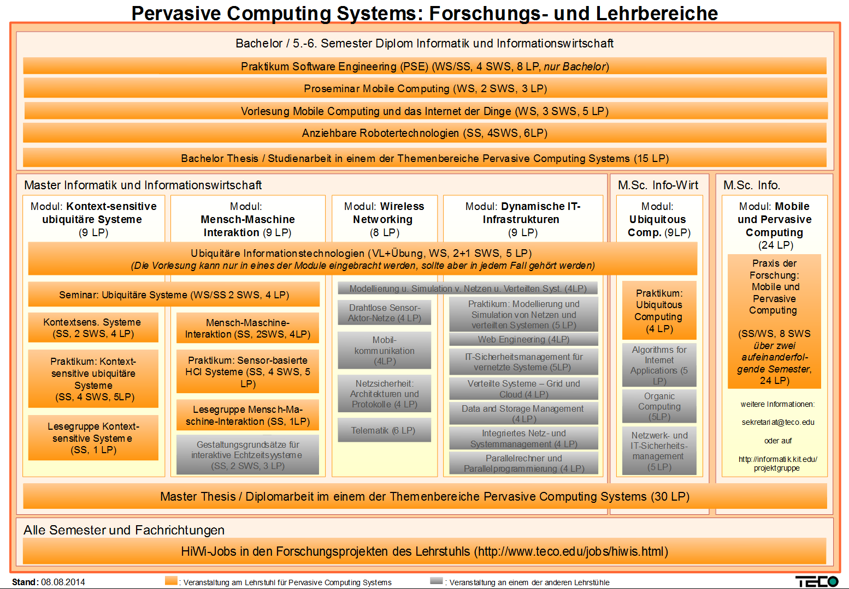
Module
Warning: OLD SPO

Slide 5
Exam

Slide 6
Context sensitive systems lecture
IoT and Systems Lecture!
Focus on Analytics but with Application Focus!
Focus on Time Series Data!
Subtitle: Internet of Things Data Analytics
There is also other very good lectures on Data Analytics
Focuses on understanding and drawing conclusions
Foci might change slightly based on your demand
Exam relevant basic knowledge will be pointed out
Thus presence is highly recommended
Discussion helps you to understand the subject
There is no such thing than bad question!
2SWS = 4 Credits
Oral
Registration for exam: Frau Schierholz (pcs.tm.kit.edu)
Exam Preparation
Try to communicate the topics of the lecture with peers
There is something to learn and to understand:
Understanding takes time
At best work constantly throughout the semester
Lesegruppe
For some students that need 1 additional Credit (InWi)
Please contact me after today‘s lecture

Slide 7
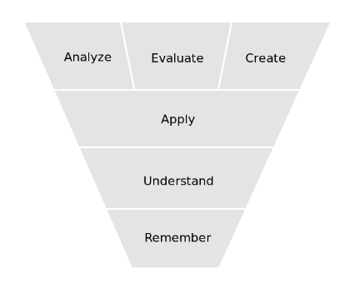
Do not learn for the exam…
…but for life
Explore the tutorial, try to create something yourself
read basic material
critically evaluate
state of the art applications
revised Bloom's taxonomy
EXAM

Slide 8
Systems are about thinking in structures…

Slide 9
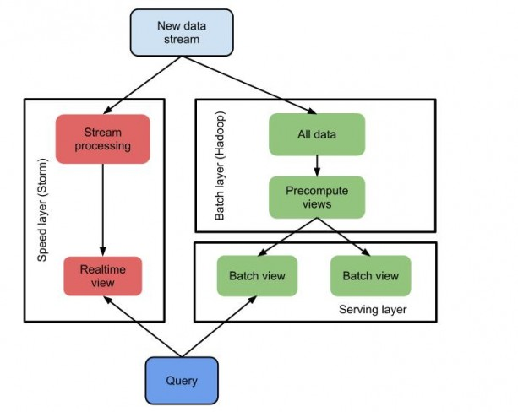
… and transforming for application

Slide 10
Content of this lecture
Intro and Motivation
Sensing and Middleware
/ 8. Features in Data
/ 9. Prediction
/ 10. Classification
Vertical Application
Fusing Knowledge
Context oriented Programming

Slide 11
Defining Context
Webster:
1 : the parts of a discourse that surround a word or passage and can throw light on its meaning 2 : the interrelated conditions in which something exists or occurs
Often used as a synonym for: Surrounding, circumstance, situation, meta-information, ambient, ...
Wikipedia:
Context (language use), the relevant constraints of the communicative situation that influence language use, language variation, and discourse summary
Archaeological context, an event in time which has been preserved in the archaeological record
Opaque context, linguistic context in which substitution of co-referential expressions does not preserve truth

Slide 12
Context in Computer Science?
Computer Linguistic: surrounding information of text
System Architecture: the virtual environment required to suspend a running software program
Lexical context or runtime context of a program, which determines name resolution
Context in mobile and ubiquitous computing
All surrounding information
Including real world contexts: location, activity, situation
Context awareness: a complementary to location awareness
Context in opposition to Content
Challenge
sense and classify the surrounding information
build computer systems that react more appropriate based on context

Slide 13
Context in Pervasive Computing
Pervasive Computing Systems
[from Latin pervādere, from per- through + vādere to go]
IBM-Definition: “Convenient access, through a new class of appliances, to relevant information with the ability to easily take action on it when and where you need”
Context Sensitive: „when and where you need it“
Notes:
102, 193, 255

Slide 14
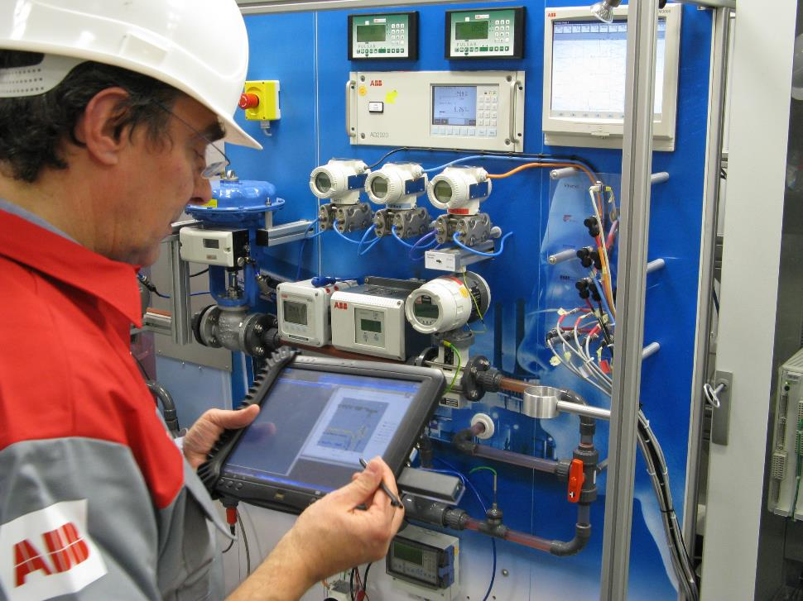
teco.kit.edu Industrie 4.0
Context Aware Maintenance

Slide 15
Context optimizes!
In human communication, situational info is implicit, to increase the conversational bandwidth
Goal: Make interaction with computer systems more efficient
The limiting factor of IT is often not processor speed or memory size, but limits of human attention.
Especially in mobile computing, situation changes frequently and the user is preoccupied with other tasks
Context-awareness is enabling technology

Slide 16





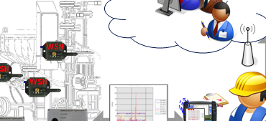
Beyond State: Context-awareness in Industrie4.0
Context
Recognition and Interaction
Production Context
Environmental Context
Economic Context
Work/Process Context
Sensor/Actor
Maschine
Product
Human
Software is Core Part here:
Context-aware production
Autonomic,reactive,…
HCI: Mobile Maintenance
Ad-hoc Processes
SmartX+ AugmentedX

Slide 17




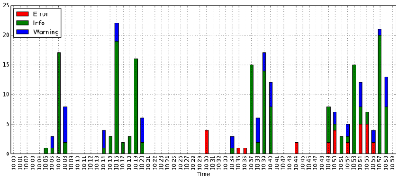
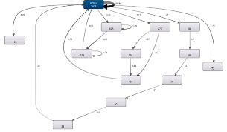
Condition-Based Maintenance
Analysis of Machine Logs to Enhance Maschine Diagnostics and Condition-Based Maintenance of Industrial Production Machinery
Sequence and process mining to capture behaviour of machines during production, maintenance and failure.
Focusing on individual machines. Future: Complex machine networks.
Learned models are validated on the data itself and are used to predict future machine states and behaviour.
Vision is to provide prediction to particularly challenging production scenarios to optimize the production and reduce downtimes

